Slide 1
A STATISTICAL CONSULTANCY REPORT | PUBLIC HEALTH INDICATOR ANALYSIS
Predictive Anaemia Screening and Healthcare Resource Planning
Using Full Blood Count Data in Sri Lankan Healthcare Institutions
| Module: IT3081 Statistical Modelling |

Slide 2
PRESENTATION ROADMAP
What We'll Cover
1
2
3
4
Industry Problem
Data & Modelling
Innovation Proposal
Expert Validation
Why anaemia, why this client, and why now.
What the data shows and what we built.
What we're asking the Board to do.
How a real expert tested our thinking.

Slide 3
CONSULTANCY OBJECTIVES
A Data-Rich, Insight-Poor Health System
•
Uneven capacity: Documented lab technician shortages at primary care.
Consultancy Goals
•
Understand FBC dataset risk patterns.
•
Untapped data: FBC collected at scale, unexploited for proactive action.
•
Establish statistical evidence of risk.
•
Stakeholders: Patients, clinicians, management, MoH, and donors.
•
Build and evaluate a predictive model.
•
Translate findings into validated innovation.

Slide 4
RESEARCH LANDSCAPE
A Gap Between Two Literatures
Global Predictive Studies
Sri Lankan Context
Our Justification
High accuracy, low external validation.
Prevalence known, prediction lacking.
•
Coverage: All-age, multi-institution scale.
•
Performance: Schipper et al. (2024) reports AUROC 0.84–0.88.
•
Focus: Amarasingha et al. (2022) targets children/pregnant women.
•
Approach: Interpretable models over black-boxes.
•
Methodology: Simple logistic regression rivals complex ensembles.
•
Gap: Elderly explicitly flagged as understudied.

Slide 5
DATASET SELECTION & UNDERSTANDING
27,034 Patients, Four Institutions, One Dataset
222K
6
0
12
Zenodo FBC Records
Red-Cell Parameters
Missing Values
Age Errors Removed
Business Value: Every variable is collected in routine care. Zero marginal data-collection cost for immediate, clinically plausible deployment.

Slide 6


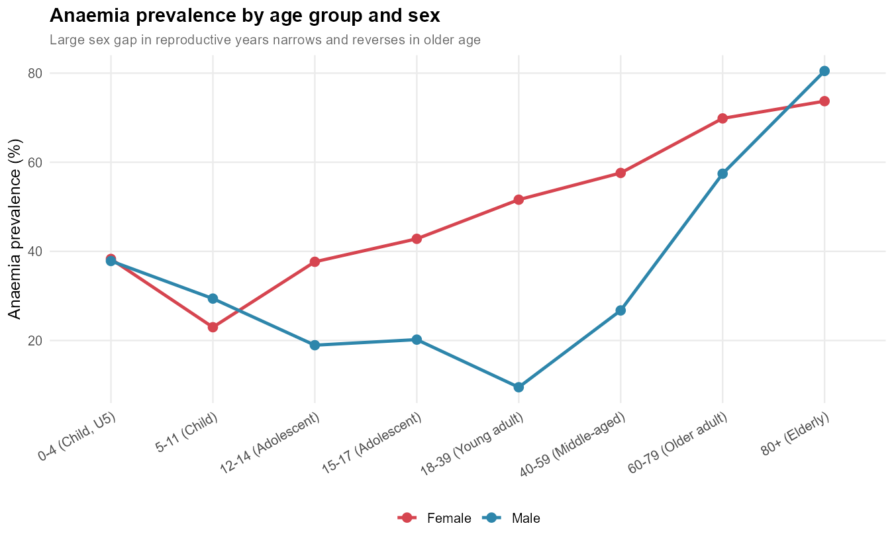
INITIAL INSIGHTS
The Age × Sex Reversal
43.6% Overall Prevalence
•
Severity: 294 severe cases retained in data.
•
Reproductive years: Women dominate risk (51.6% vs. 9.5% in men, ages 18–39).
•
Elderly reversal: Men peak at 80.5% (vs. women 73.7%, ages 80+).
•
Multicollinearity: HB-PCV highly correlated (r = 0.96).
Insight: A uniform "target women" policy misses the highest-risk group entirely.

Slide 7
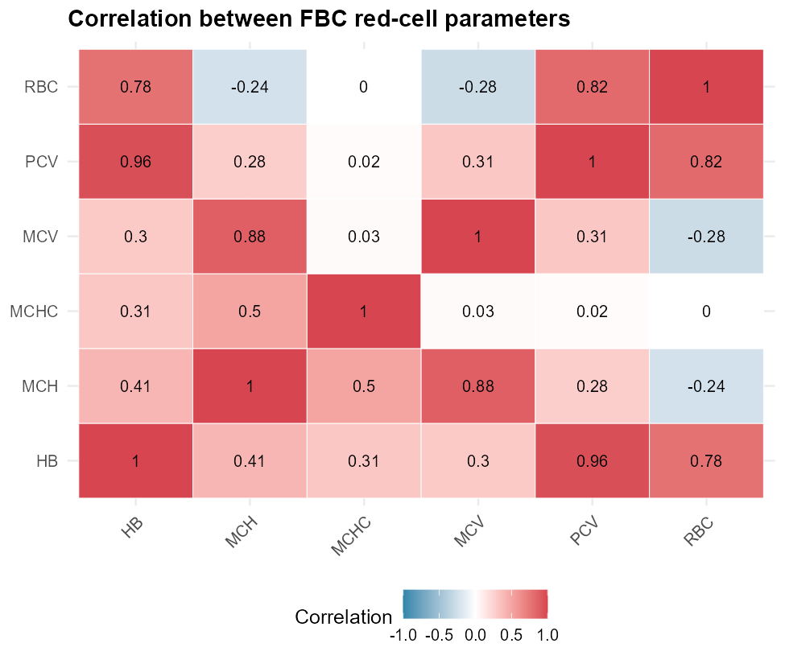
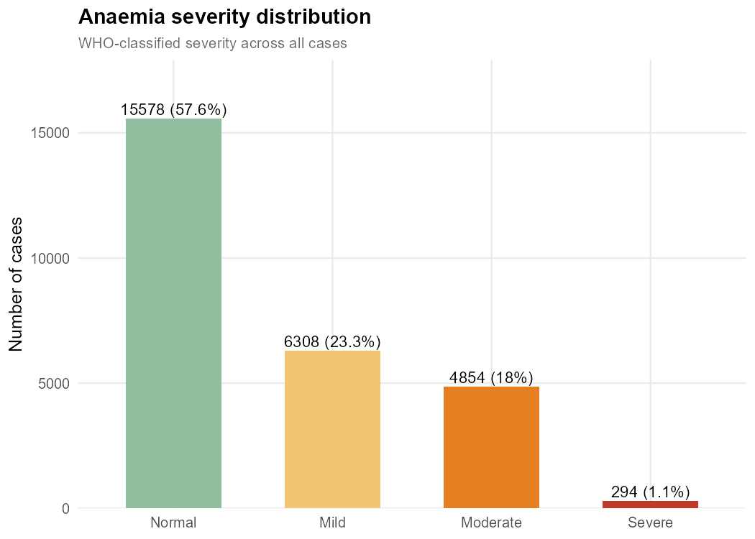

Slide 8
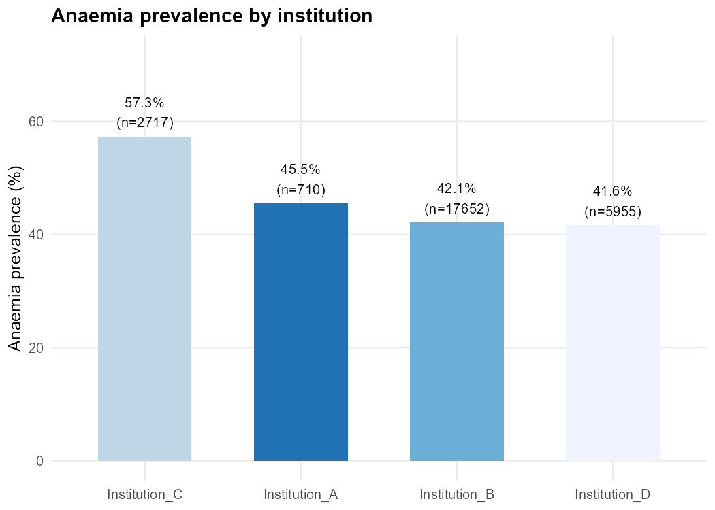
STATISTICAL INFERENCE
Seven Hypothesis Tests, One Story
•
Methods used: Welch t-tests, 2-prop z-test, chi-square, 1-way/2-way ANOVA.
•
Gender gap confirmed: Women 1.85× male rate (54.2% vs 29.2%, p < 2.2×10⁻¹⁶).
•
Interaction verified: Age×sex interaction significant (η²=0.066).
•
Institution effect: Weak variation driven by one site (Cramer's V = 0.093).
Implication: Treat institutional differences as a targeted investigation, not a system-wide alarm.

Slide 9

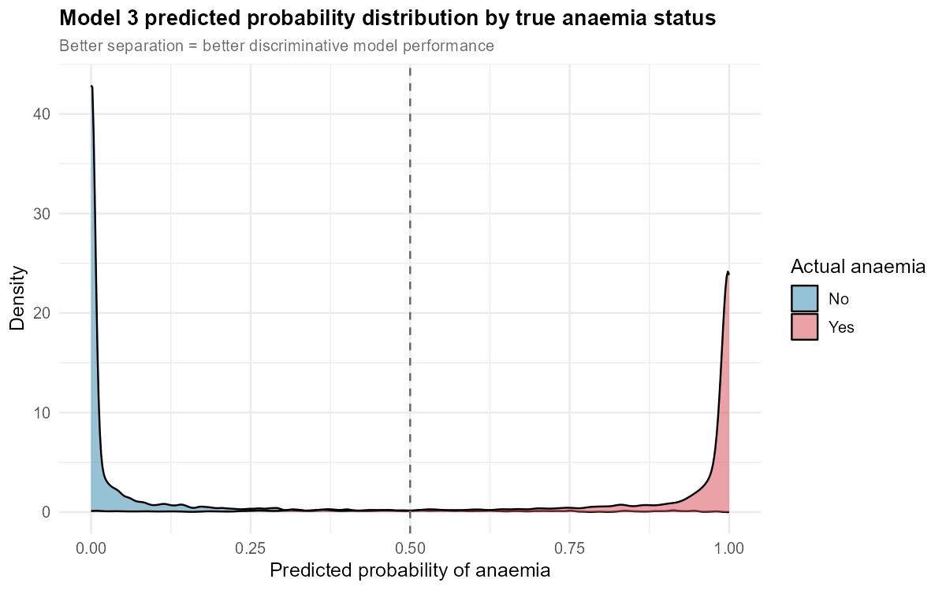
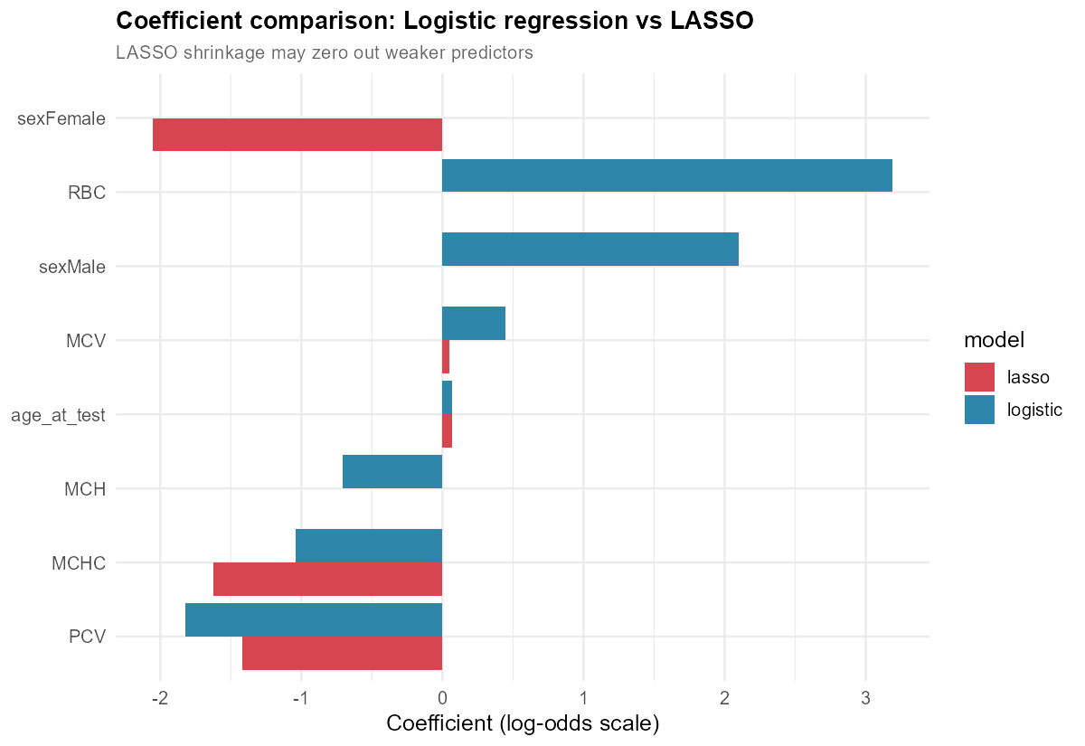
PREDICTIVE MODELLING
Predicting Without Reading Haemoglobin
94.4%
Accuracy (AUC 0.986)
•
Baseline VIF: MCV 461, MCH 388 (severe collinearity).
•
Model Options: Ridge, LASSO, and Elastic Net compared.
•
Performance: Logistic regression interaction solves baseline.
•
Deployment: Elastic Net stabilizes coefficients safely.

Slide 10
EXPERIMENTAL DESIGN EVALUATION
If We Ran a Future Trial, Here's How
CRD (Pure Randomisation)
RCBD (Blocked by Institution)
Fits a small, single-institution pilot (e.g., low-cost reminder interventions). Complexity isn't justified by sample size.
Directly justified by evidence. Real constraint: one site is only 2.6%. Simulation shows RCBD cuts imbalance ~50×.

Slide 11
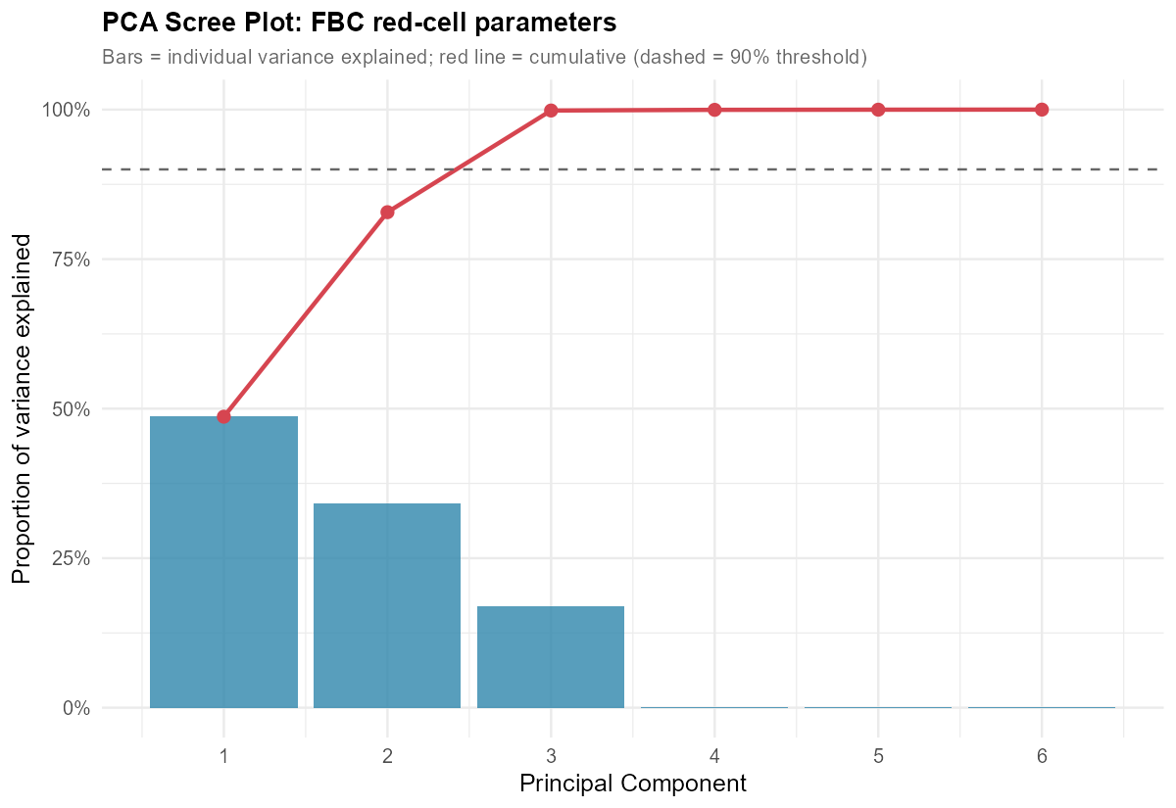
PCA EVALUATION
When Dimensionality Reduction Doesn't Pay Off
•
Marginal need: Only 6 lab variables; tested for collinearity.
•
Interpretability: Yielded "mass" and "size/content" components.
•
Performance cost: 2 components (82.8% variance) worsened AIC from 6,754 to 7,402.
•
Verdict: Elastic Net remains superior, preserving interpretability at no cost.

Slide 12
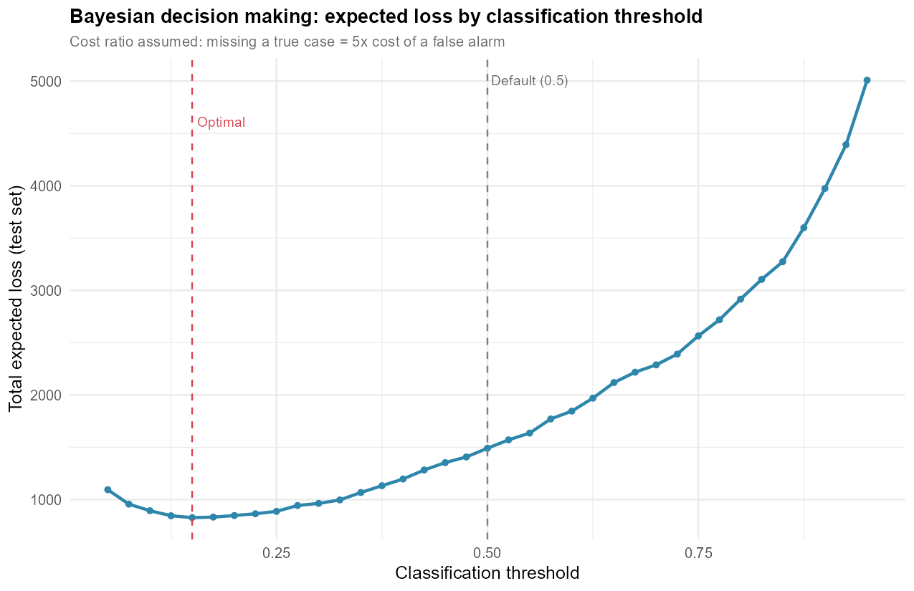
BAYESIAN STATISTICAL METHODS
A Smarter Decision Rule Matters
44.5%
Reduction in Expected Error Cost
•
Naïve Bayes: Underperformed (88.3% vs. 92.5%); viable fallback.
•
MCMC Fix: Gelman's prior solved perfect class separation.
•
Asymmetric costs: Missing a case costs 5× a false alarm.
•
Impact: Cost-calibrated threshold drastically reduces errors.

Slide 13


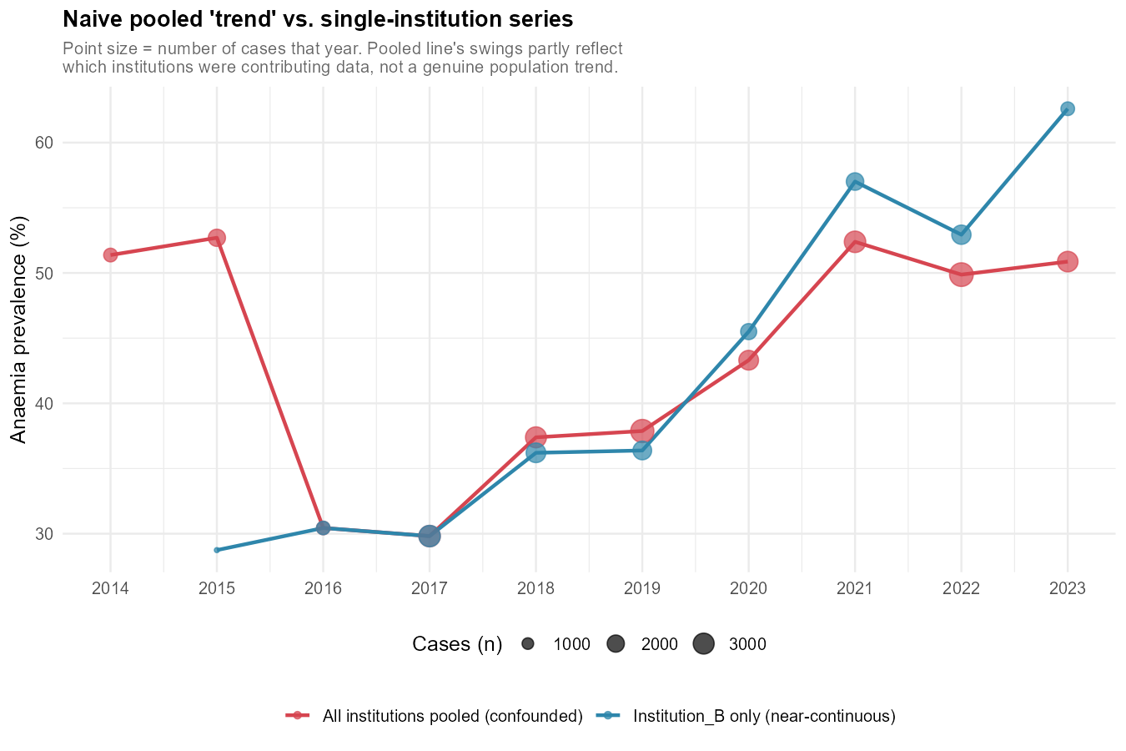
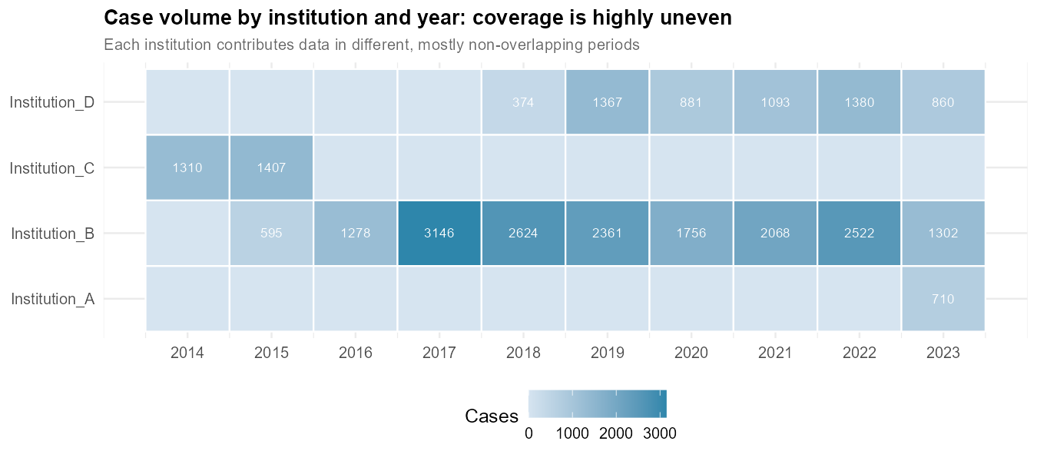
TIME SERIES EXTENSION
We Have Dates, But Not a Time Series
The Trend Gap: 2014–2023 non-overlapping reporting means pooled trends are misleading.
ARIMA Future: Ghana/Iraq models prove viability for seasonal (monsoon) pre-positioning.

Slide 14
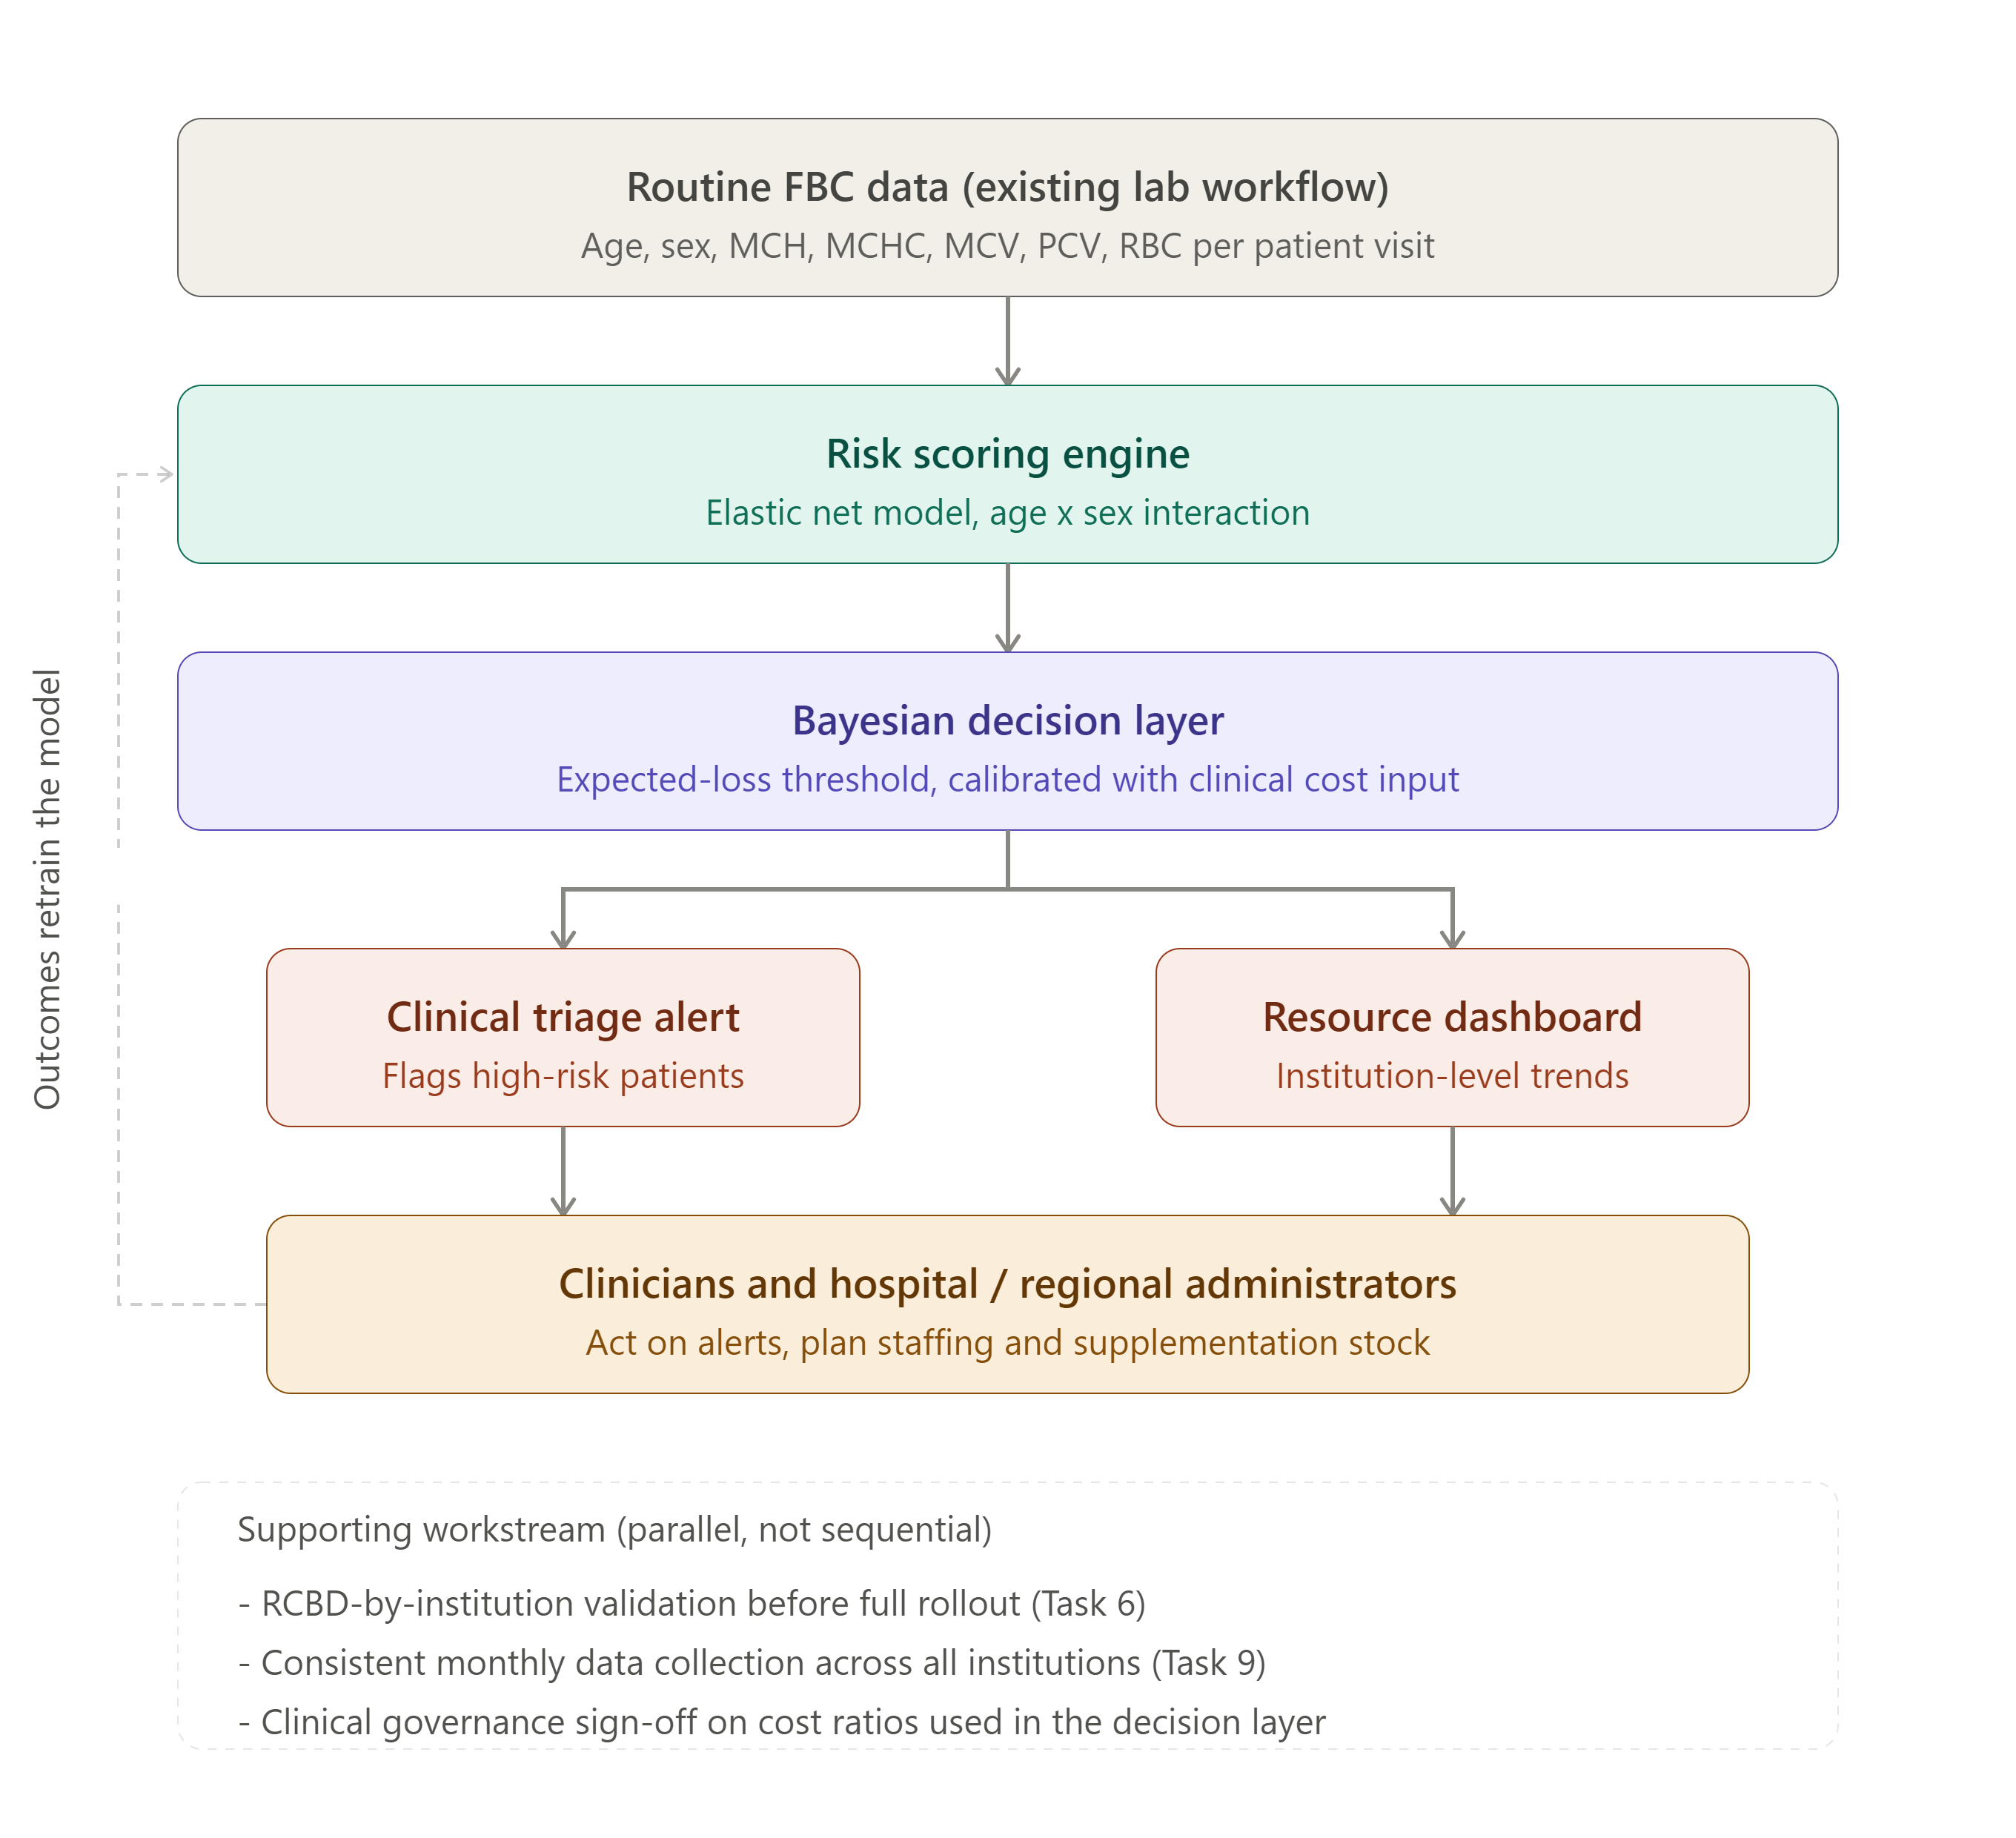
INDUSTRY INNOVATION PROPOSAL
The Anaemia Early Warning Framework (AEWRAF)
1. Risk Engine
Deploy the Elastic Net logistic model at point of care.
2. Decision Layer
Apply Bayesian cost-calibrated thresholds.
3. Triage Alerts
Institutional resource-planning dashboard alerts.
~40% error cost reduction. Requires LIS integration and clinical buy-in.

Slide 15
INDUSTRY EXPERT VALIDATION
Tested Against Real-World Judgement
Expert Profile
Applied Feedback
[Name, Title, Organisation]
[Format of consultation]
[Specific changes implemented post-feedback regarding relevance and feasibility]
Evidence documented via signed findings-summary sheet.

Slide 16
FINAL CONSULTANCY RECOMMENDATIONS
What We're Recommending to the Board
Strategic
Operational
Adopt age/sex-stratified policy; position FBC screening as a high-leverage lever.
Deploy Elastic Net model; investigate high-prevalence institution directly.
Risk & Ethics
Future Steps
Audit fairness (65% data from one site); maintain explainability; clinicians retain accountability.
Execute RCBD trial; implement ARIMA forecasting; explore hierarchical models.

Slide 17
Thank You
Happy to take your questions.

